Slide 1
Student Seminar - IDP
Presentation 5
Can Ersoy - 27.10.2026

Slide 2
Tests
Testset: 2873 scraped papers with XML full-text available
Relevance Check (gemini-3.5-flash-lite)
Extraction (gemini-3.5-flash-lite)
Evaluation (mistral-small3.2:24b)
Notes:
Normally the order of the tests is that we do relevance check before receiving full-texts
But since I tried to get full-text for all retrieved papers until now, we don’t do that

Slide 3
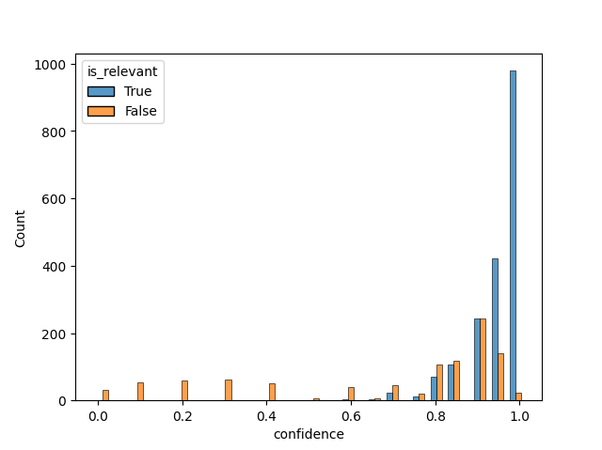
Relevance Results
is_relevant (2873)
True: 1869
False: 1004
Notes:
I think what we see is a pattern with LLMs that give overconfidence for cases where a positive outcome is given where with negative outcomes it gives low confidence… It might also be the result of a part of the prompt for this task where we tell it that skipping papers that actually have peptide entries is worse than processing papers that don’t actually have any

Slide 4
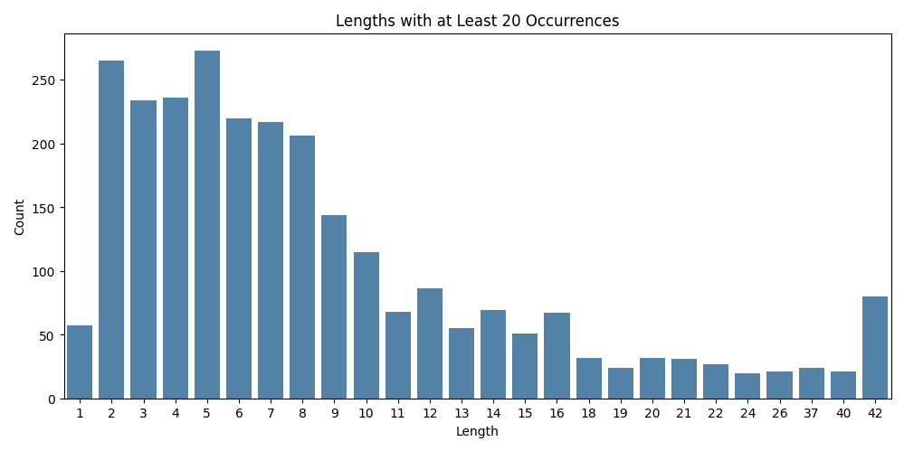
Extraction Results
Used 1490/1869 relevant papers
38 papers had no entries
2866 total entries
Papers with no extracted entries -> Potential improvement to relevance check
Notes:
Here: we only prompt relevance check about 4-20 length and not the extraction… the result here might be more related to relevance actually

Slide 5
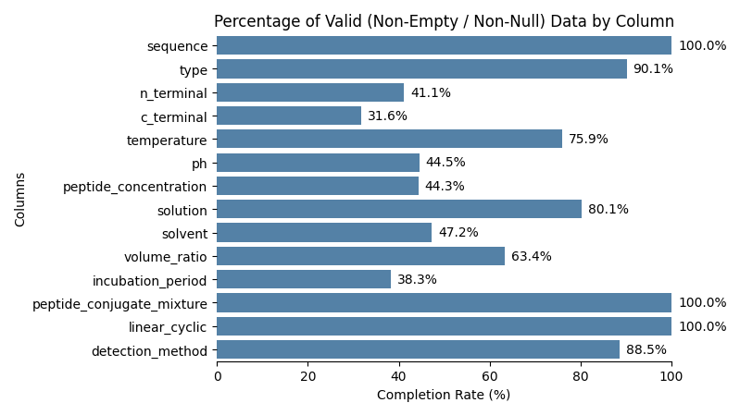
Extraction Results (2)
Notes:
This doesn’t include
Length (it is calculated as the string length of sequence)
Doesn’t include conjugate partner since only a small amount of entries (only conjugate/mixture forming) has one
Doesn’t include preparation protocol (due to processing error actually no real reason)

Slide 6
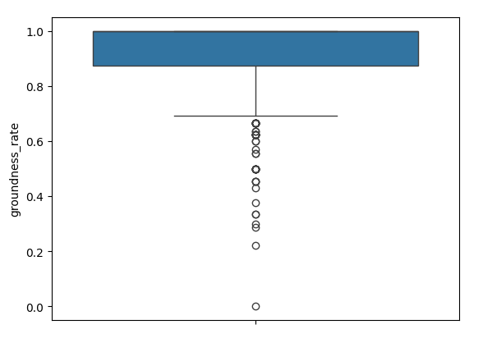
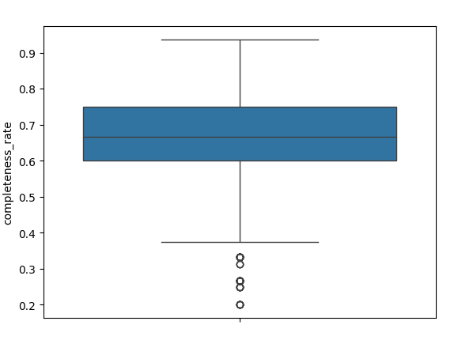
Evaluation Results (only 500/2866 extraction entries)
Notes:
We don’t need faithfulness anymore since groundness captures both cases:
If location is provided and exists in paper (original groundness check)
LLM decides if the value is in the text sequence for that location (faithfullness from before)

Slide 7
Considerations (1)
Google API is much faster than GPU server (low priority):
Relevance Check Task (batches of 10 for 40 papers):
  gemini-3.5-flash-lite: 0.6 seconds/paper
  mistral-3.2small: 6.25 seconds/paper
Relevance check for 2873 papers took <30 minutes with google api vs ~20 hours (estimate) on gpu server
Notes:
This is a low priority thing but even with a much bigger model, google api seems to be much faster with tasks (when available)
This is not an issue with network latency, the token/seconds is low
Context length is important: 32k had 27 t/s vs 128k had 18t/s speed

Slide 8
Considerations (2)
Small models like mistral-small3.2 (24b) / gemma 4 (31b) perform really poorly on extraction task:
1) 2)
{ "entries": [
{
"sequence": "FKFEFKFE",
"type": "amyloid",
"ph": 7,
"conjugate_partner": "N-acetylated and C-amidated",
"preparation_protocol": "....",
"evidence_span": {
"type": "paragraph",
"solvent": "water",
"conjugate_partner": "N-acetylated and C-amidated"
}
},
{
"sequence": "FKFEFKFE",
"type": "amyloid",
"ph": 7,
"conjugate_partner": "N-acetylated and C-amidated",
"preparation_protocol": "...",
"evidence_span": {
"type": "paragraph",
"solvent": "water",
"conjugate_partner": "N-acetylated and C-amidated"
}
}
{ "entries": [
{ "sequence": "FKFEFKFE", "evidence_span": { "sequence": "[sec-0/p-0/s-3]" } },
{ "sequence": "FKFEFKFE", "evidence_span": { "sequence": "[sec-0/p-0/s-5]" } },
{ "sequence": "FKFEFKFE", "evidence_span": { "sequence": "[sec-0/p-3/s-0]" } },
{ "sequence": "FKFEFKFE", "evidence_span": { "sequence": "[sec-0/p-3/s-1]" } },
{ "sequence": "FKFEFKFE", "evidence_span": { "sequence": "[sec-0/p-3/s-2]" }
...
Notes:
Left side: same prompt with bigger model
Right side: smaller system prompt with less importance on evidence extraction

Slide 9
'sequence': ['FKFEFKFE'],
'type': ['ribbon'],
'n_terminal': [None],
'c_terminal': [None],
'temperature': [25],
'ph': [None],
'peptide_concentration': [None],
'solution': ['water'],
'solvent': [None],
'volume_ratio': ['1'],
'incubation_period': [None],
'peptide_conjugate_mixture': ['peptide'],
'conjugate_partner': [None],
'linear_cyclic': ['linear'],
'detection_method': ['Cryo-EM'],
'preparation_protocol': ['The Cryo-EM structure of the FKFEFKFE peptide (PDB ID: 7LQF) was downloaded.'],
'evidence_span': ['{"sequence":"[sec-0/p-0/s-3]","type":"[sec-0/p-0/s-3]","temperature":"[sec-1/sec-2/p-1/s-1]","solution":"[sec-0/p-1/s-0]"}'],
Notes:
This is an example for the same paper extracted by gemini

Slide 10
Questions
For extraction, should we stick with large models (like Gemini 3.5 Flash Lite) or adapt the code to make it work with small models?
Notes:
I am not sure if it would scale with large models due to rate limits and potential costs…

Slide 11
Notes
PMC Open Access Subset returned 55k full-text XML for the query: “peptide self-assembly”. Next step could be to use these papers (relevance -> fetch -> process)

